Slide 1

Stay or Stray? A Time-Varying Survival Analysis
Tyler Allen, Riley Sallander, JD Singh, & Owen Hanson
Notes:
To-do–
Change colors on slides 10/11 + change legend
Review font in title vs body
Visual slide 3
Specific Agenda

Slide 2
Agenda
Visual Analysis for Individual Customer Survival Probabilities in Relation to Risk
Our Model That Can Accurately Predict Customer Churn for 1, 3, & 5 Year Periods
Risk Classification
Customer Recommendations Specific to Risk Level
Notes:
Specific agenda

Slide 3
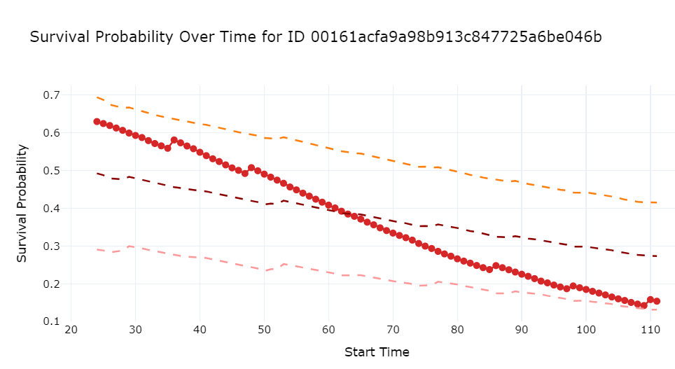
Risk Assessment With the Click of a Button
001
(Top dotted line)
Mean + 1 std
(Mid dotted line)
Mean survival probability based on tenure
(Bottom dotted line)
Mean - 1 std
Survival Probability
2009-09
2013-03
2017-03

Slide 4
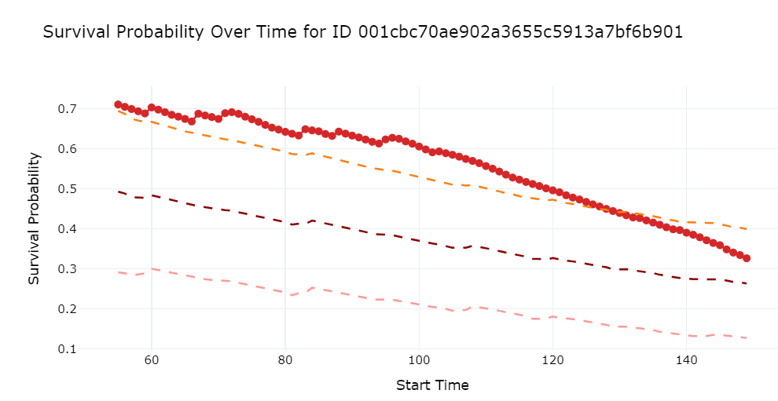
Low Risk Customer Example
002
(Top dotted line)
Mean + 1 std
(Mid dotted line)
Mean survival probability based on tenure
(Bottom dotted line)
Mean - 1 std
Survival Probability
2011-01
2014-05
2017-10

Slide 5
Cox Time Varying Model Using Landmarks
… why is this useful?
It allows us to forecast probabilities of customer survival and classify customers that are at risk of churning
… how good is this model?
Notes:
The model estimates churn risk for each customer at different time periods, and allows us to forecast…

Slide 6
For customers who have been around 1 year, how well can we predict if they churn?
72.1% Recall on test data
(Among all customers who actually churned within a year, our model correctly identified 72.1% as churners)
69.0% Precision on test data
(Of all customers that our model predicted would churn within a year, 69.0% actually did)

Slide 7
For customers who have been around 3 years, how well can we predict if they churn?
67.8% Recall on test data
(Among all customers who actually churned within 3 years, our model correctly identified 67.8% as churners)
67.2% Precision on test data
(Of all customers that our model predicted would churn within 3 years, 67.2% actually did)

Slide 8
For customers who have been around 5 years, how well can we predict if they churn?
64.2% Recall on test data
(Among all customers who actually churned within 5 years, our model correctly identified 64.2% as churners)
62.8% Precision on test data
(Of all customers that our model predicted would churn within 5 years, 62.8% actually did)
Notes:
Churn date is set to 5 years before they first expire
The 3 and 5 year models are predicting based off a different sample due to tenure

Slide 9
High vs Low Risk Customers
Low Risk Traits
Longer contract durations
Higher engagement
Fewer fluctuations in x1/x2, with 0 or positive net change
High Risk Traits
Shorter contract durations
Changing customer status
Higher fluctuations in x1/x2, negative net change
Why the distinction?
Our predictive models can use segmentation to identify what exactly separates a low risk customer vs a high risk customer
Notes:
Split by trait “you now know that when you see a customer fluctuate contracts within short periods, —-”

Slide 10
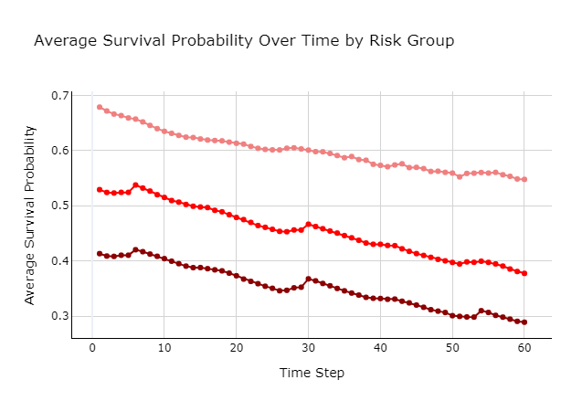
Very High Risk Customers Have the Lowest Average Survival Probability Across All Points of Tenure
Low Risk
High Risk
Very High Risk
Below 1 std of the mean survival probability

Slide 11
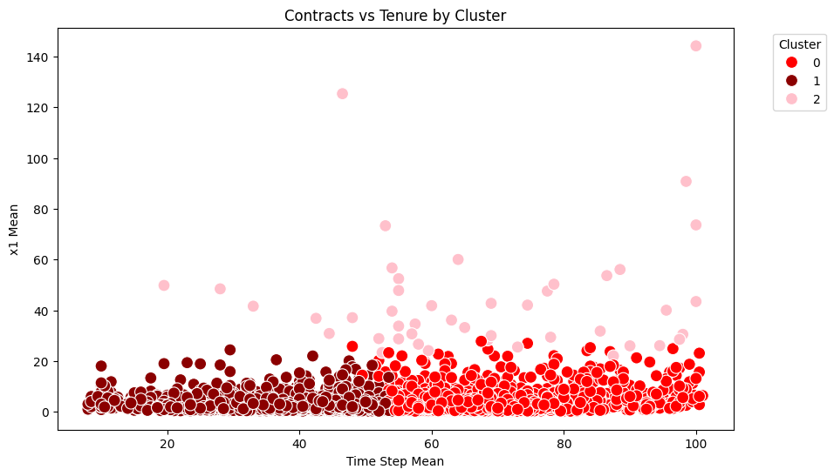
High Risk Customers Can Be Segmented into High Tenure vs Low Tenure for Targeted Churn Prevention Strategy
Short Tenure Group
Long Tenure Group
Big Spenders
Notes:
Once we have identified the high risk customers, we want to know what kind of customers they are, to be able to employ preventative strategies more effectively. When clustering customers with a high risk of churning in 1 year, there appears to be 2 primary types– Long time customers and newer customers. There is a third cluster of high spending customers across all tenures, but this group is marginal. On it’s own the groupings are shallow, however – (next slide)

Slide 12
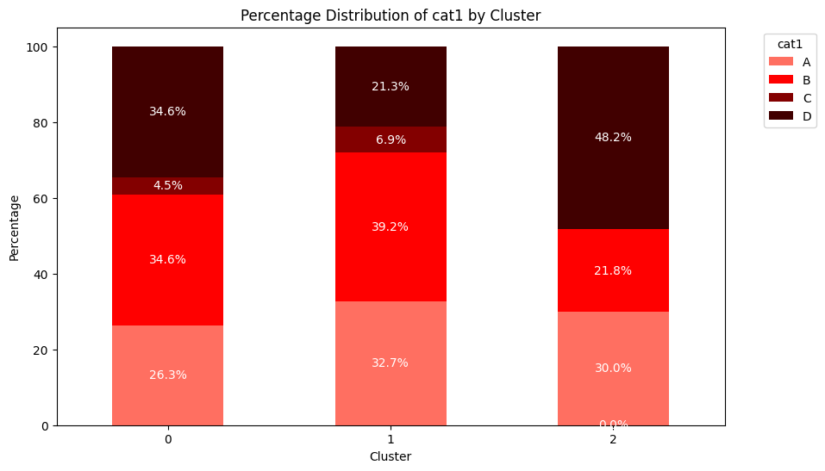
Differences in Company Attributes Allow You to Refine These Strategies
Long Tenured
Short Tenured
Big Spenders
Notes:
When combined with categorical clustering, we see that the two groups have different company attributes. The long tenured customers at high risk of churn have a much higher proportion of D selection in category 1. Depending on what this signifies, this approach allows you to target your marketing efforts to these customers, with more efficiency and personalization when you use our model and clustering technique. These attributes are identified early on the customers lifecycle, and can be used preemptively to plan marketing strategies if they do become at risk of churning.

Slide 13
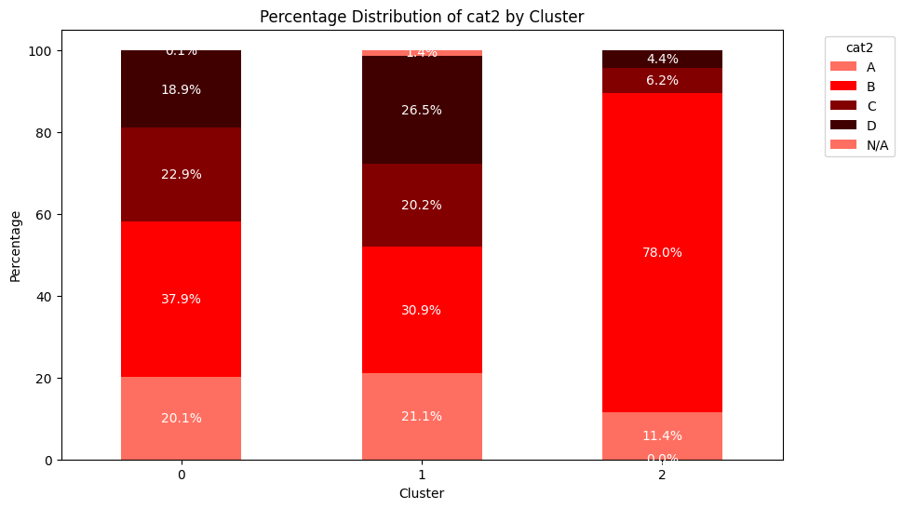
Differences in Company Attributes Allow You to Refine These Strategies
Long Tenured
Short Tenured
Big Spenders

Slide 14
Recommendations
Assess Customers Individually: Utilize individual plots to identify customers who are potential candidates for larger contracts or who may require intervention
Identify Churn: Use our model to identify if a customer will churn in the next year, giving customer retention teams the opportunity to reach out and solve the customers’ specific issues
High Risk Behaviors: Identify customers with short contract duration and who fluctuate in their contract amount (x1/x2), as they are more likely to churn

Slide 15
Thank You!
Any Questions?

Slide 16
